Slide 1
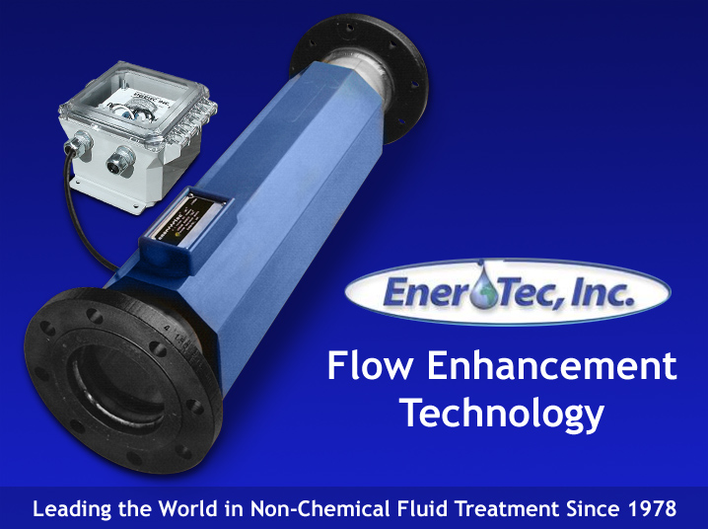

Slide 2
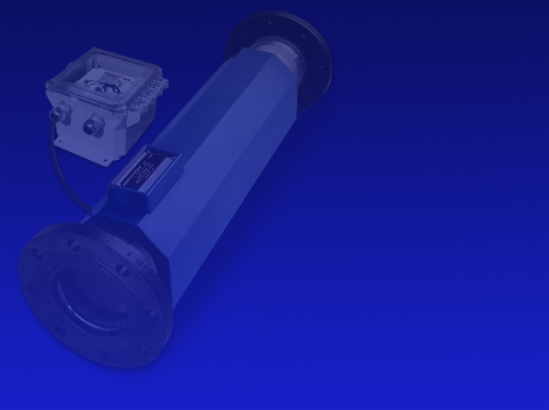
History
Ener-Tec, Inc. was incorporated in 1978 after many successful prototype installations of the LKC on boilers, cooling towers, ice machines, process water, etc.
A vast amount of application data has been accumulated throughout the commercial and industrial markets enabling complete evaluation of each new installation.

Slide 3
Prevent Scale Deposition
Non Chemical
Non Restricted Flow
Low Operating Cost
No Maintenance
Little Space Requirement
Non Polluting
Fast Return On Investment
Prevents And Removes Buildup

Slide 4
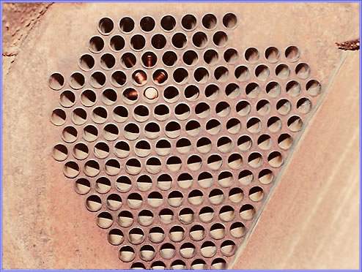
CHILLER AFTER ONE YEAR OF TREATMENT WITH LKC

Slide 5
Principle of Operation
The Linear Kinetic Cell (LKC) is composed of an induction coil having thousands of feet of insulated copper wire powered by a pulsating DC Electrical current. This pulsating energy forces a majority of the atoms within the fluid to align parallel to one another lowering the energy to a level that crystals cannot form as scale or paraffin deposits.

Slide 6
Return On Investment
The LKC System has a very fast return on investment (R.O.I.) of typically one year or less.
Customers have reported paybacks of under 3 months.

Slide 7
Environmental Impact
The LKC System is a physical method of changing the molecular structure in the liquid (oil, water, etc.) so it has different characteristics. This is no different than changing the characteristics of steel by heat treating or cryogenics. The same molecules are still there, only in a different arrangement or pattern.
In either case nothing was added or taken away.

Slide 8
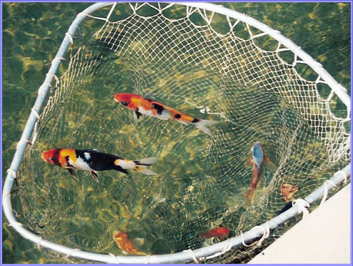
KOI IN LKC TREATED COOLING TOWER BASIN

Slide 9
Required Maintenance
Due to the unique design, the LKC requires no routine maintenance.
There are no components inside the pipe to restrict flow or require cleaning.
We only ask the customer to make visual checks on the power supply amp meter to confirm that there is current going to the cell.
No system maintenance is required.

Slide 10
What Is Blow Down?
Blow down is discharging concentrated water from the the system. Concentration is due to evaporation from heat and/or air leaving the solids behind.
Blow down procedures are critical if using LKC or chemicals in order to maintain an acceptable TDS (total dissolved solids) level.
Contact us for specific blow down questions.

Slide 11
Blow Down Procedures
As with chemical use, blow down is required
in boiler and cooling tower applications.
In cooling towers a TDS (total dissolved solids) level of between 1500 and 2000 ppm recommended. This is normally about 5 cycles or 5 times the make up water tds.
We recommend following the same blow down rate for boilers that was previously used during chemical treatment.

Slide 12
Installation
Installation of the LKC system is done utilizing standard plumbing and electrical procedures. Heat sinking the copper pipe next to the urethane is required when sweating LKC into system.
Power supply is pre-wired and all the
AC and DC terminals are clearly marked.

Slide 13
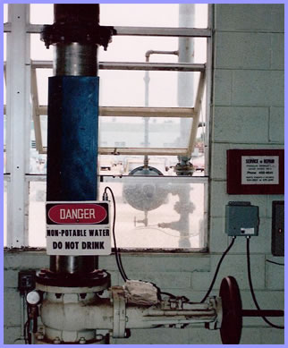
8” LKC on cooling tower
in die cast plant.

Slide 14
Where Is LKC Applied?
The LKC is applied wherever scale or paraffin buildup is a problem. In oil fields the most common applications are the oil wells and pipelines as well as boilers for heating crude oil.

Slide 15
Temperature Rating
The maximum temperature rating for the standard urethane encapsulated system is 200 degrees F. Higher temperature rated units are available for applications when required.
There is no minimum temperature rating
since the cell generates a small amount
of heat within the cell.

Slide 16
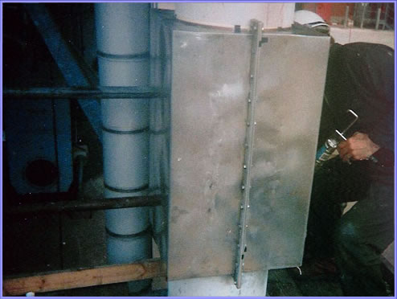
SPECIAL 36” LKC IN REFINEREY COOLING TOWER

Slide 17
Electrical Requirements
The LKC power supply operates on 110 or
220 VAC, 50/60 Hz (specify when ordering).
Ener-Tec, Inc. can design special systems
to operate on other AC And DC voltages
that are available.
The average system operates at 2 to 4 amps.
Due to continuous operation and amperage
draw solar power is normally not feasible.

Slide 18
Where Is LKC Installed?
For pipelines install the LKC at the beginning of the pipeline. For boilers, the cell is installed after the pump that pumps condensate and make up water back to the boiler. The LKC is installed in the cooling tower loop after the pump. For single pass water systems install the LKC at the inlet to the building or equipment being treated. Contact Ener-Tec for guidelines to all other installations.

Slide 19
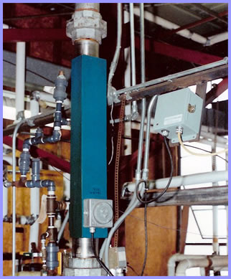
3” LKC in plating plant.

Slide 20
Power Plants
There has been an increase in the number of LKC systems installed in power plants over the past several years. This is due to the high chemical cost and loss in efficiency when heat exchangers etc. get the smallest amount of scale deposits.
1/8 inch of scale can decrease efficiency by at least 20%.
The R.O.I. (return on investment) is very fast.

Slide 21
Sewage or Lagoon Treatment
The LKC system is very effective in increasing flocculation (settling) of solids in waste water facilities and other applications where solids are settled out of solution.
This may be in lagoons, holding tanks, or other vessels.
Many of our systems are installed on heat exchangers and boilers in sewage treatment plants.

Slide 22
Zebra Mussel Control
Ener-Tec, Inc. develops electronic systems which effectively control zebra mussel growth and reproduction. This works by lowering the energy in the minerals within the zebra mussel to the point that the shell cannot form.
See website for details.

Slide 23
Static Control System
Ener-Tec, Inc utilizes the same technology
in the static control system developed to
reduce static in pneumatic conveying of
plastic pellets, flour, grains, etc.
The LKC is installed into your existing line
with standard pneumatic pipe couplings.
Let us evaluate your static problems.

Slide 24
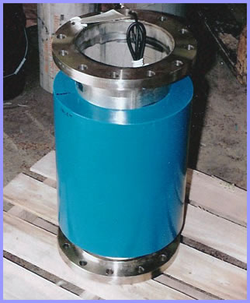
SPECIAL LKC FOR STATIC CONTROL IN PLASTIC PELLETS

Slide 25
Customers
News Release: August 22, 2006
Akita Drilling of Canada tested the LKC System against chemical wash over a 7 month period.
Quote: “The LKC beat the chemicals hands down regarding hard water
scale elimination.”

Slide 26
Customer List - Water
U.S. Steel
Inland Steel
LTV Steel
National Power
Amp Corp.
Ebco Metal Finishing
Racine Plating
Plastics Engineering
Asama Foundry
Tyco
Martin Engineering
Viam
Koch Materials
U.S. Gypsum Co.
Braddock Heat Treat
Dalton Corp.
Cryovac
Oxford Automotive
Kraft Foods
Briggs & Stratton
Ocean Spray
Plus thousands more

Slide 27
Water Lift/Oil Wells
Many LKC systems have been installed on oil wells, both off shore and on shore where water is pumped down hole to lift the oil. Scaling is always a problem and can be solved by installing the LKC on the discharge side of the pump.
Unlike chemicals, the LKC adds nothing to the oil/water that has to be removed later.

Slide 28
Oil / Water Separation
The LKC system is being used in oil /water separation eliminating the demulsifier previously used. One customer was spending $5,500.00 a year on demulsifiers before replacing it with the LKC system. They were getting 8% water carry over in the oil before LKC was installed. Now they have a .4% carry over after activating the LKC.
The LKC lowers the energy and surface tension that bonds the water and oil atoms/molecules to each other allowing a more efficient separation.

Slide 29
Explosion Proof Systems
Explosion proof systems are available in all sizes to meet the Class I, Div. I, Group D codes for installation in hazardous locations.

Slide 30
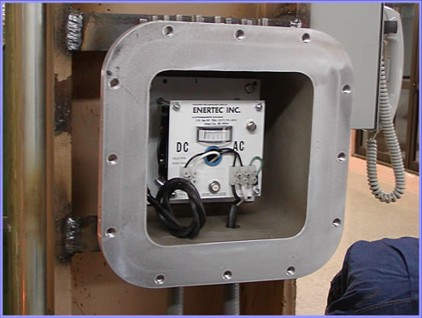
EXPLOSION PROOF POWER SUPPLY WITH COVER REMOVED

Slide 31
Customer Service
If power supply has to be returned for inspection or repair we offer a 24 hour turn around time eliminating the need for the customer to inventory spare parts.
If cell has to be rebuilt it requires two to three weeks.
Returns are very few due to design and construction.
Ener-Tec, Inc. customer service number is
Tele. (517) 741-5015 Fax: (517) 741-3474

Slide 32
Warranty / Guarantee
Ener-Tec, Inc. offers a one year performance guarantee as well as a five year warranty on the total system. Ener-Tec, Inc. has the right to void the warranty and guarantee if the equipment has been tampered with and/or not installed according to the installation instructions shipped with each system.

Slide 33
Customers
The industrial sector includes nearly all the major corporations including auto manufacturers, food plants, steel mills, foundries, plastics molding, glass companies, paper mills, power plants, etc.

Slide 34
Customers
Egypt
LKC was installed on an offshore platform which increased production by 24% by eliminating scale and paraffin. Shutdown for cleaning is no longer required.

Slide 35
Thank You
On behalf of Ener-Tec, Inc. I want to thank each of you for taking time from your busy schedule to view this presentation.
If you have any particular questions please contact us at your convenience.
Larry L. Shroyer, President
Ener-Tec, Inc. USA
Tele :(517 )741 5015
Fax: (517) 741 3474
Email: larry@ener-tec.com

